Slide 1
Resource Constrained Project Scheduling Problem

Slide 2
Overview
Resource Constrained Project Scheduling problem
Job Shop scheduling problem
Ant Colony Optimization Approach
  Biological analogy
  Coordination in Ant Colonies
  Ant System
Implementation
Future Directions
Conclusions

Slide 3
Resource Constrained Scheduling problem
RCPSP is a classic project scheduling problem.
Activities have precedence constraints.
Activities are subjected to capacity constraints.
Applying Ant colony optimization for a Job shop scheduling problems, which is considered as a special case of RCPSP.
The main objective of job shop scheduling is to minimize the time taken to complete all the jobs in a job shop.

Slide 4
Job Shop Scheduling Problem
N-job, M-Machine Job shop problem.
It is represented as N/M/G/C_{max}
The processing order of machines is denoted by a technological matrix T.
T = M₁ M₂ M₃
M₂ M₃ M₁

Slide 5
Processing time of each operation is specified by matrix P.
t(o₁₁)………. t(o_{1m})
P = t(o₂₁)………..t(o_{2m})
t(o_{n1})……….t(o_{nm})
Cmax is the production time that takes to finish all the jobs, taking into account the imposed restrictions of machine occupation.

Slide 6
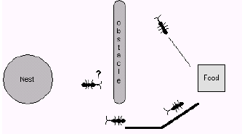
Ant Colony Optimization
Biological Analogy:
Ant Colony behavior is structured
Good co-ordination exists among the ants.
Ants exhibit a famous phenomena called foraging
and recruiting behaviour.
Ants communicate indirectly through pheromone.
Pheromone acts as distributed memory.
Inspired by this behaviour many researchers developed different algorithms.

Slide 7
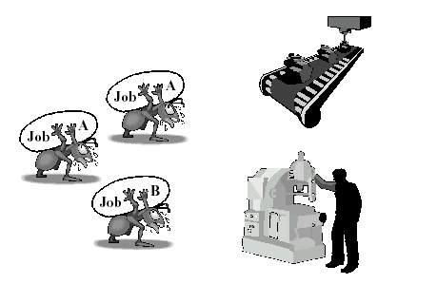
Co-ordination in Ant Colonies
Ant Colony can be stated as an example of a highly distributed natural multi-agent system.
Double bridge experiment.
Functions efficiently in spite the loss of individual agents(ants).
Experimentally it was proved the entire efficiency was due to the pheromone released by the ants.

Slide 8
Ant System
Basic principle of the algorithm is to have I artificial ants.
The algorithm imposes the problem definition to a graph.
Ants move from node to node in the graph by the following State Transition Rule:
p_{ij}(t) = ([τ_{ij}(t)]^{α} .[1/d_{ij}]^{β}) / Σ _{j ∈allowed nodes} ([τ_{ij}(t)]^{α} .[1/d_{ij}]^{β})
τ_{ij} – Quantity of pheromone on the edge between node ‘i’ and node ‘j’.
d_{ij} –Heuristic distance between node ‘i’ and node ‘j’.
p_{ij}-Probability to branch from node ‘i’ to node ‘j’.

Slide 9
When the ants have constructed complete solution, Pheromone Global Update Rule is applied.
τ_{ij}(t+n) = (1-ρ). τ_{ij} (t) + ρ Δ τ_{ij} (t+n)
Δ τ_{ij} (t+n) ={ Q/f_{evaluation}(best_so_far)
0,otherwise
- evaporation coefficient
Q- quantity of pheromone per unity of distance

Slide 10
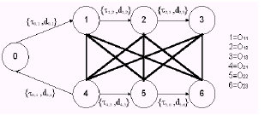
Implementation

Slide 11
It is necessary to define the problem as a graph. The above figure Shows a definition of 2/3/G/C_{max.} .
The maximum number of nodes of a n*m job shop is given by: Nodes = (n*m) + 1(7)
Non symmetric values are allowed.
The number of edges in the graph is given by:
edges = ((|o|.(|o|-1))/2) + n (17)
|o| = n*m
The spatial complexity of Ant system for job shop scheduling is given
by: Spatial complexity = o([n*m][n*m]) O(36)
Time complexity is given by:
Time complexity =O(NC*I*[n*m])

Slide 12
Future Directions
Static problems
Dynamic Problems
Conclusions
Ant system gives the best performance for non- symmetrical values.
It proved to be very efficient when used to solve some benchmark problems.

Slide 13
References
Andreas Grun, Sebastian, Thomas, A comparison of Nature Inspired Heuristics on the traveling salesman problem .(1998)
Arno Sprecher, Ranier Kolisch, PSLIB-A project scheduling problem library (March 1996), No.396.
Daniel Merkle, Martin Middendorf, Hartmut Schmeck, Ant Colony Optimization for Resource – Constrained project scheduling, (August 1997) No.451.
Marco Dorigo, The Ant Colony Optimization Metaheuristic: Algorithms, Applications, and Advances
R.Kolisch, S.Hartmann, Heuristic algorithms for solving the Resource-constrained project-scheduling problem: Classification and Computational analysis (1998).

Slide 14
Reisenberg, Schrimer, Parameterized Heuristics for project scheduling – Biased Random sampling methods (September 1997), No.456.
Schirmer, Case-Based Reasoning and Improved Adaptive Search for Project Scheduling (April 1998).
Sonke Hartmann, Self Adapting Genetic Algorithms with an application to project scheduling, (June 1999).
Stephen F.Smith, Vincent A.Cicirello, Insect Societies and Manufacturing (2000).

Slide 15
Thank You

